Slide 2
Why did you choose us?
To address and provide a solution to the many problems associated with your current manual filing system
-Problems include:
-Lack of organization and efficiency
-Increased data errors
-Increased use of valuable resources including time, money, and space
-Lack of information security

Slide 3
Lack of Organization & Efficiency
Current System:
-All company files and information (patient info, employee records, insurance info, bills, history) stored in physical filing cabinets
-Multiple filing cabinets in use
-Too many paper documents to maintain at once
-Much more difficult to access company data, both past and present

Slide 4
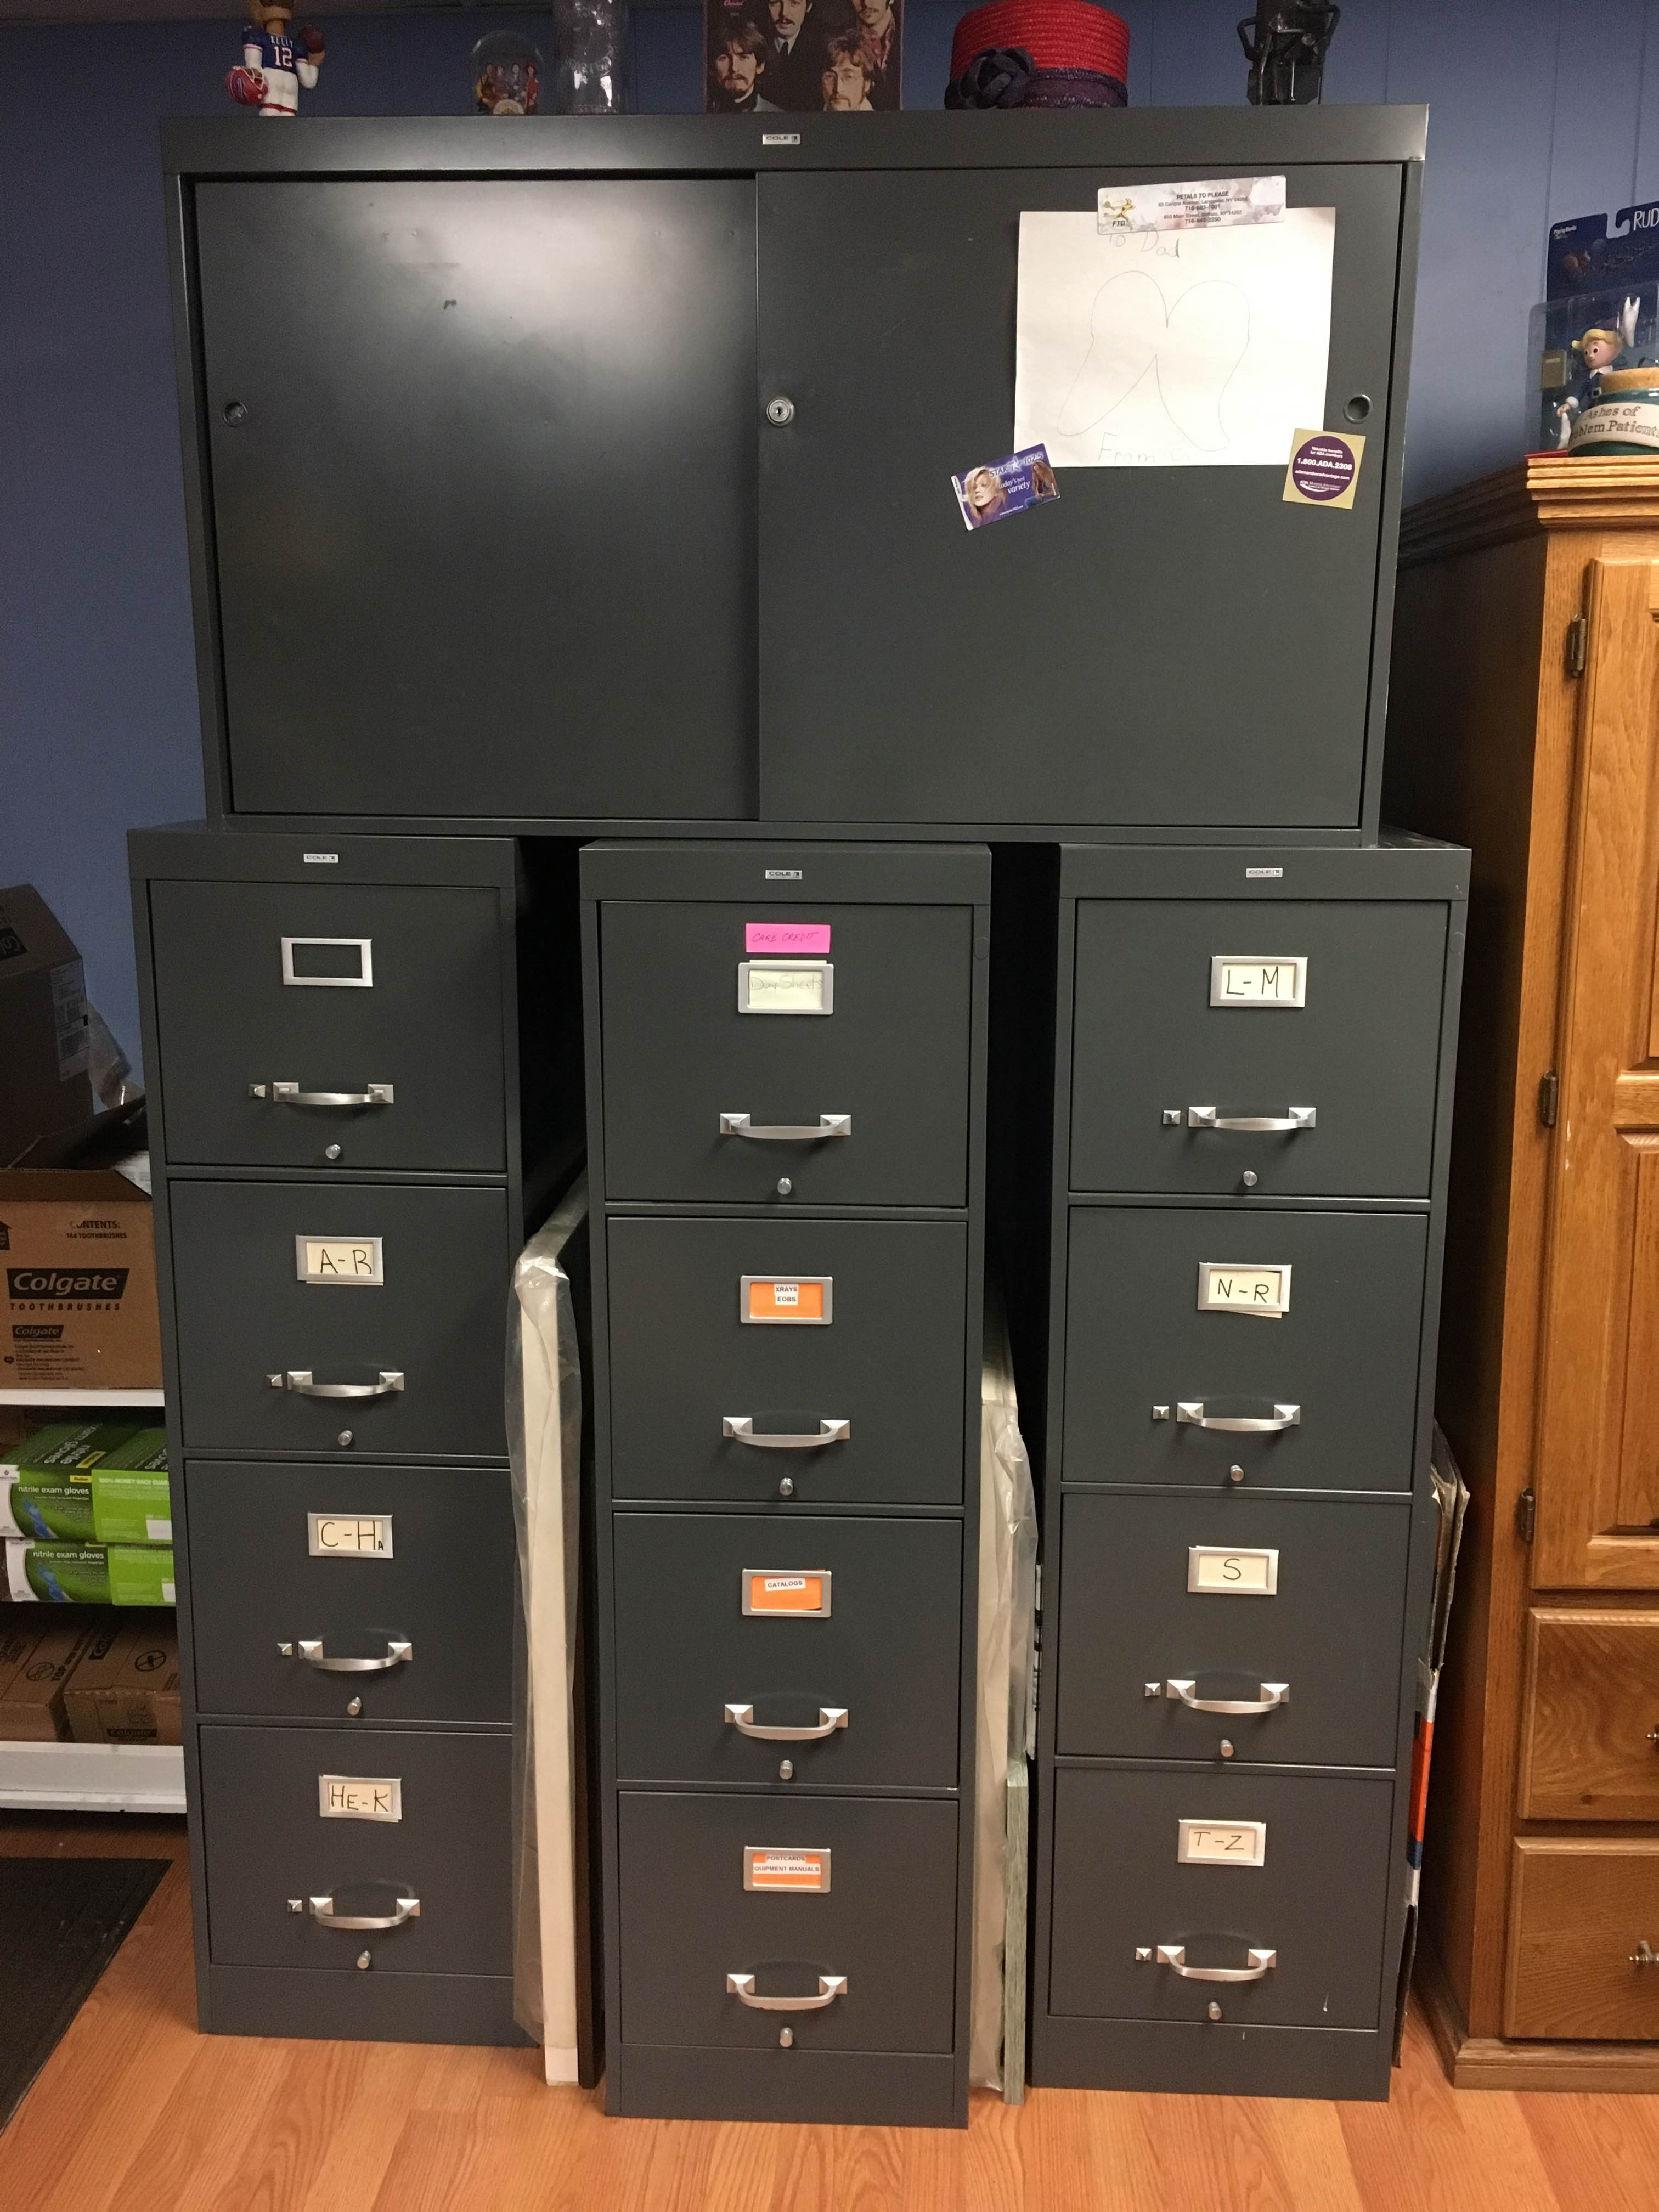

Slide 5
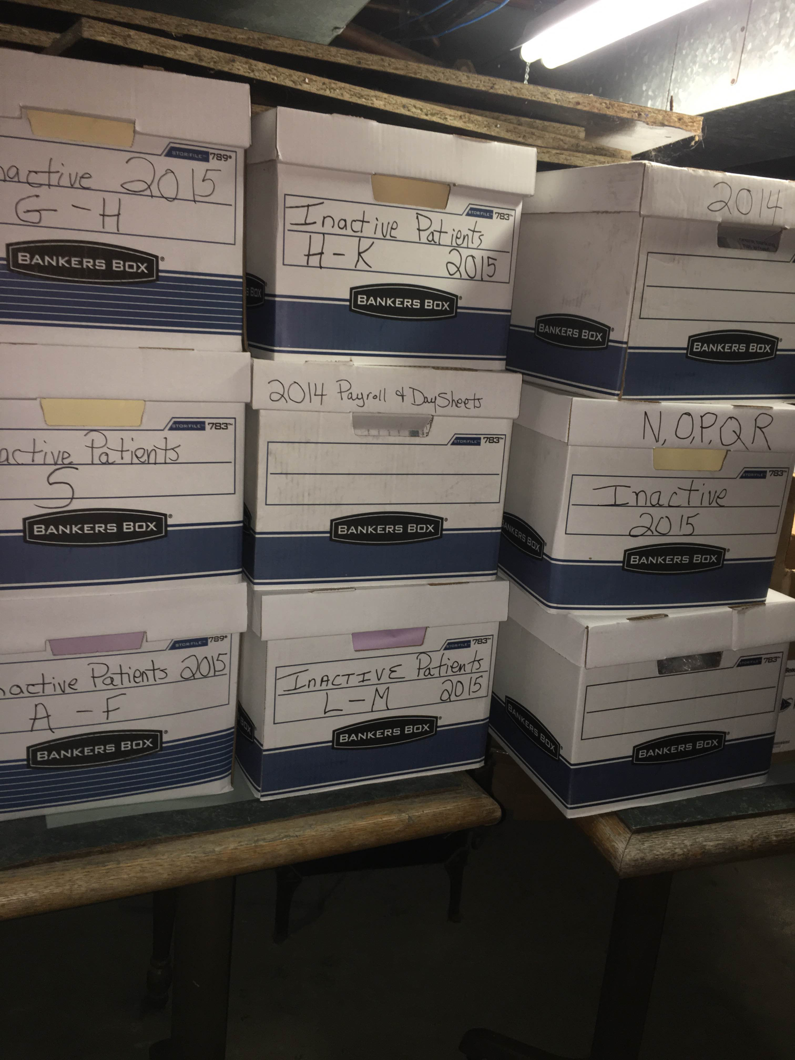
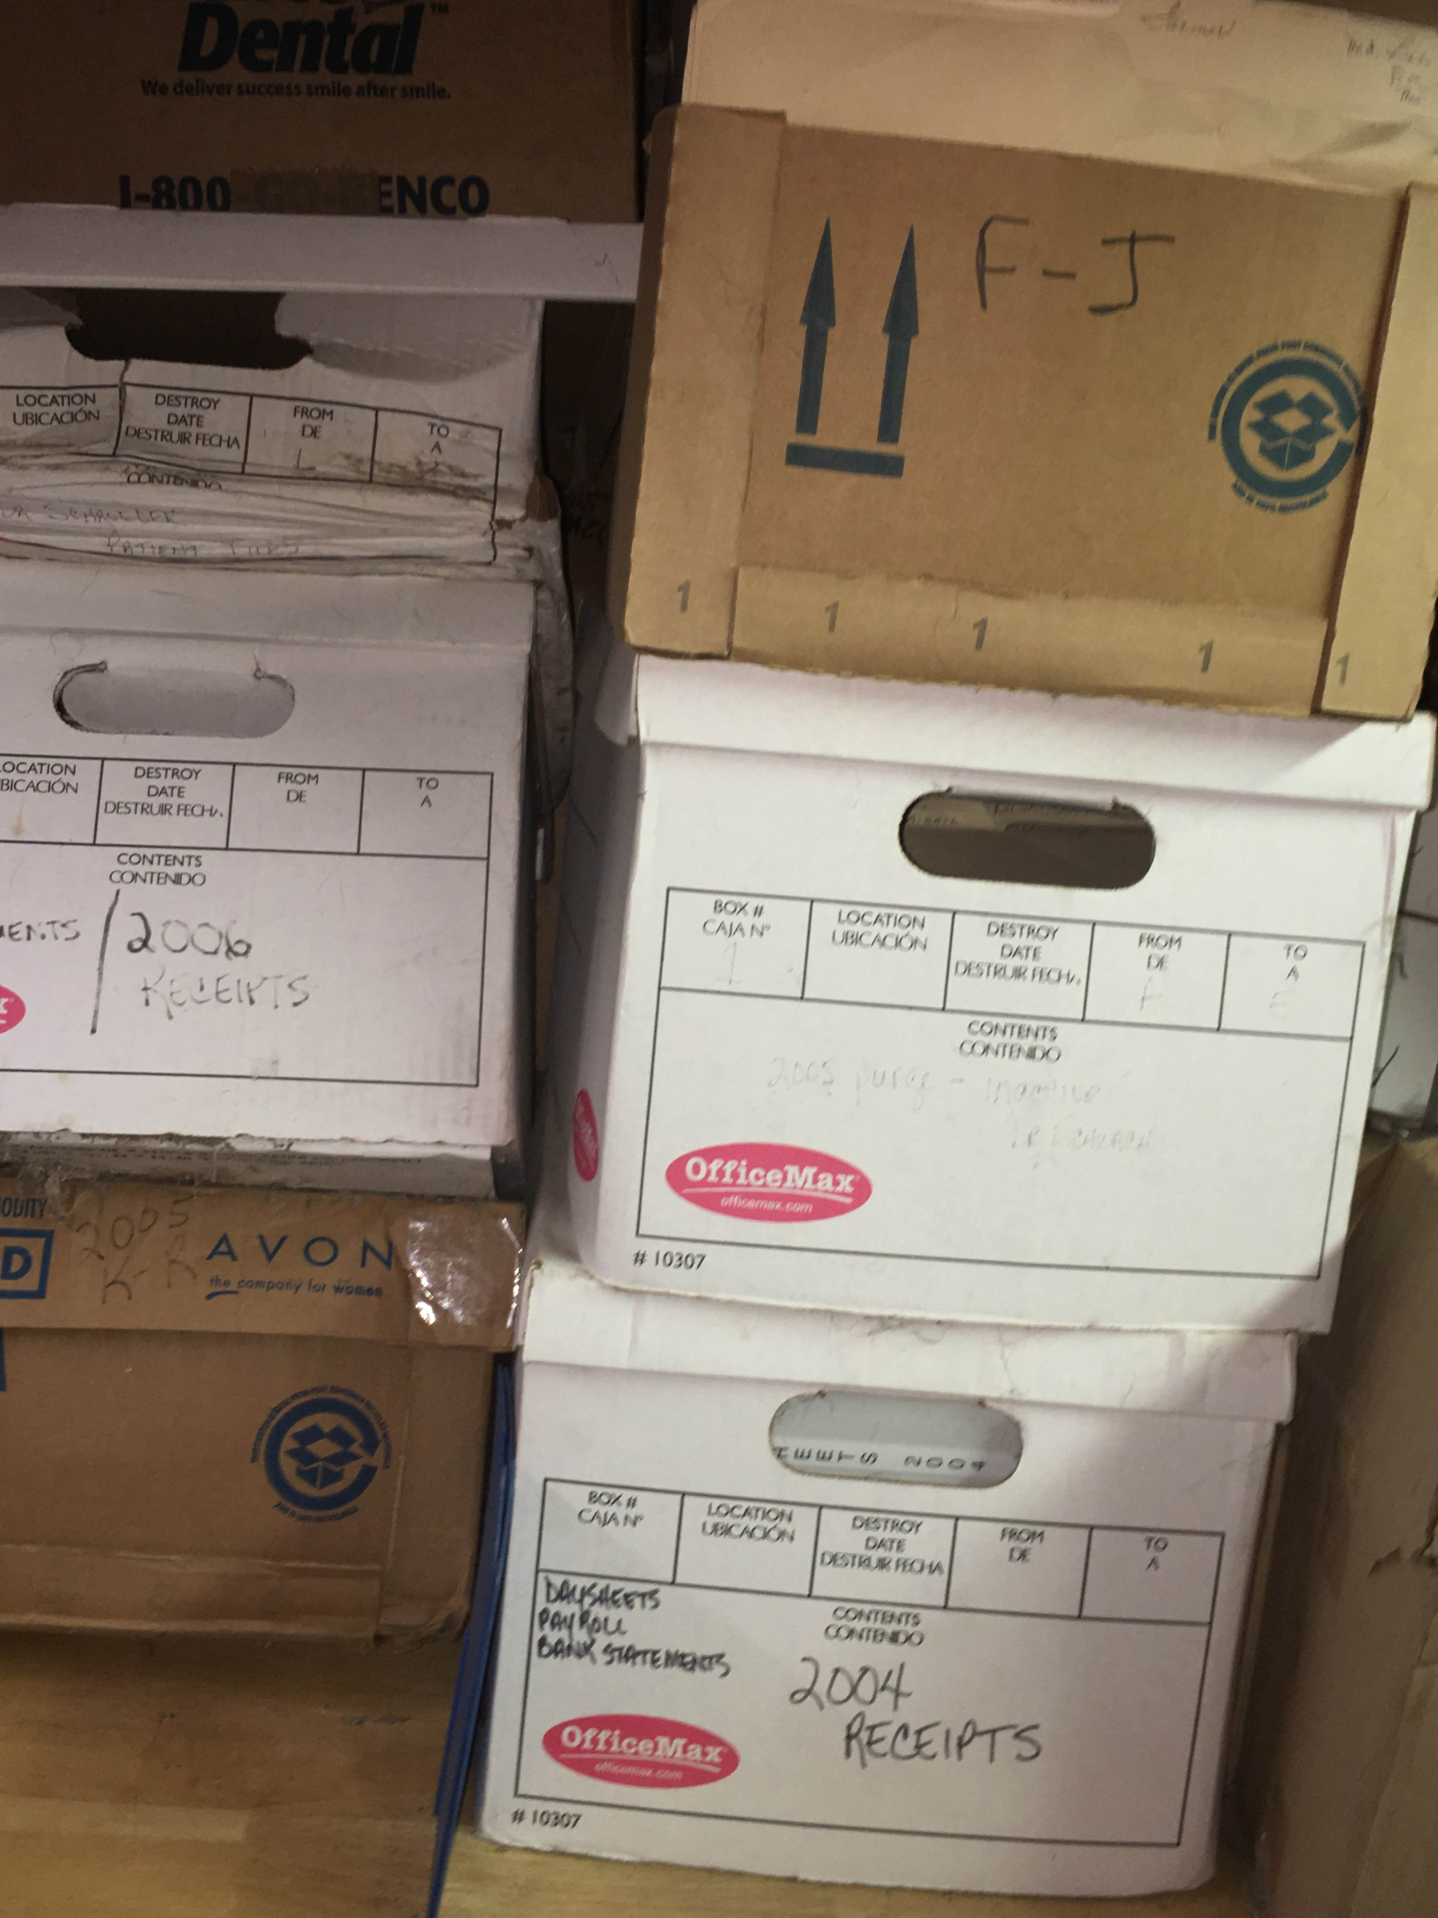
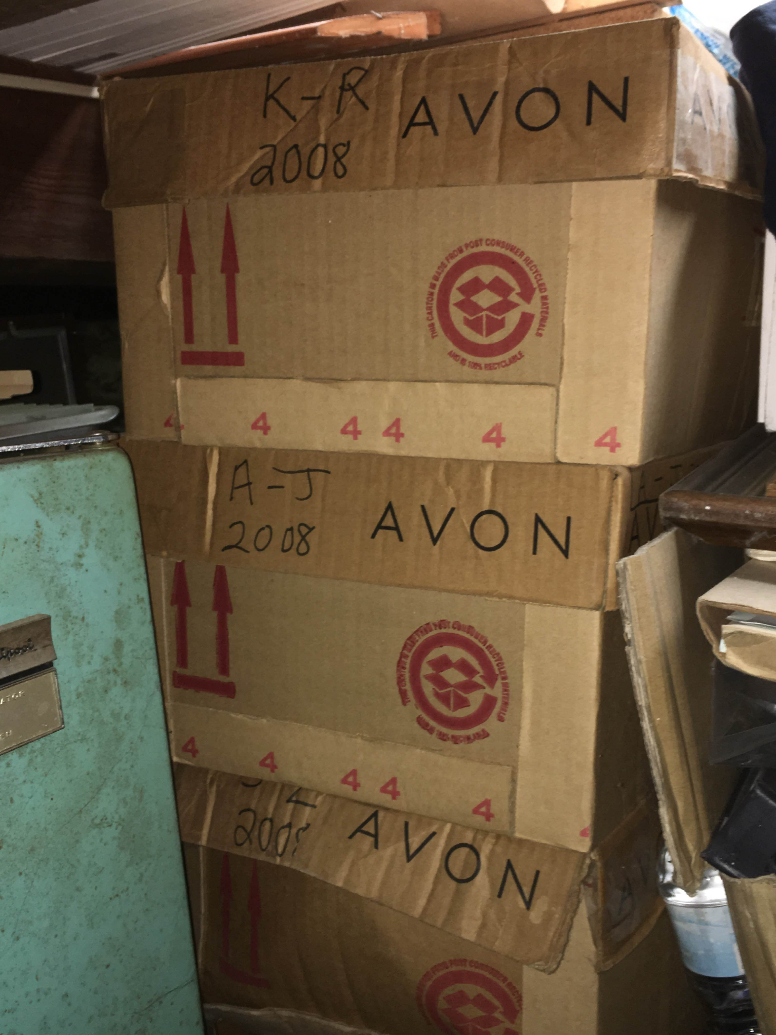

Slide 6
Increased Use of Valuable Resources
Current System:
1. Time:
-Searching through each filing cabinet for company documents and patient files
-Spending extra time manually creating and updating company data
2. Money:
-Increased labor costs due to more labor-intensive work (hand written documents and handwritten file maintenance)
3. Space:
-Filing cabinets take up extra office space that could be used for something that could increase business value

Slide 7
Increased Data Errors
Current System:
-All company documents must be handwritten
-Hard to read at times
-Mistake prone
-Lack of data entry and data verification controls in place
-If mistakes are made, they go undetected
-No guidance as to what information must be recorded and how it must be stored

Slide 8
Lack of Information Security
Current System:
-Filing cabinets secured by lock and key only
-Information can easily be accessed by an unauthorized viewer
-Lack of physical controls
-No preventive, detective, or corrective controls in use to secure information

Slide 9
What do we have to offer?
A new and improved computerized database system that will address each of the problems stated previously and provide your company with an effortless and simple ease of use and an increased sense of business value.

Slide 10
High Quality Organization & Increased Efficiency
Our System:
1. Stores all company data in computerized tables and forms
-Each organized by data type (patient info, employee info, insurance info, payment info, etc.)
2. No need for filing cabinets and paper documents anymore
3. Allows for easy look-up of company information through the use of forms

Slide 11
High Quality Organization & Increased Efficiency Cont.
4. Data inputting and maintenance is much more simple and user-friendly
5. Company reports can be generated that relate data from multiple tables together
-The reports will allow you to summarize your data and process it in a way that will aid your company in making more efficient and effective decisions and allow you to draw more accurate conclusions about the business

Slide 12
Increased Surplus of Valuable Resources
Our System:
1. Time
-Searching through data will take much less time than before
-Instead of physically searching through each filing cabinet, all employees will have to do now is type in the patient’s name/ID and all of their information will automatically be found
-Documents/data will no longer need to be manually created or updated
-Creation can be completed simply by adding a new record to the pre-existing table or form
-Updating of data can be completed simply by deleting the current data in the table or form and adding in the new data

Slide 13
Increased Surplus of Valuable Resources Cont.
2. Money
-Labor costs will be greatly reduced now that data inputting/maintenance can be performed much easier and take much less time than before
3. Space
-There will now be an abundance of extra office space that is available from the removal of of the excess filing cabinets
-This space can be used to generate new business value for your company

Slide 14
Reduction in Data Errors
Our System:
-No longer will documents be handwritten, rather they will be entered through a computer
-Illegible handwriting will no longer pose a problem
-Mistakes in data entry will be much more noticeable and much easier to fix if found
-Data entry and verification controls will be put in place to guide users on the type of data that must be entered into specific fields (such as numbers or letters), the amount of characters they are allowed to use, and the required data that is necessary in order to save the new data being inputted
-These controls will aid in the accuracy and reliability of company data

Slide 15
Enhanced Information Security
Our System:
-Preventive, detective, and corrective controls put in place
Preventive:
-Security passwords put in place to prevent unauthorized users from accessing company data
-Anti-virus software installed
-Firewalls put in place to keep unauthorized individuals out

Slide 16
Enhanced Information Security Cont.
2. Detective:
-The system will be alerted if any one of the above controls is breached
3. Corrective:
-If the system is breached by an external source, the data will be encrypted to prevent the user from truly accessing it

Slide 17
New Business Value
1. Enhanced Patient Satisfaction:
-Your patients can take comfort in knowing that their information is highly accurate, up-to-date, and secure
-They will be more assured that you will be able to contact them if necessary and that their personal information is being stored in a way that keeps unauthorized personnel from viewing it

Slide 18
New Business Value Cont.
2. Possible Business Expansion:
-With the abundance of available office space that will be presented by removing the old system and by all of the extra money that will be saved due to reduced labor costs, you have the opportunity to expand your current operations
-Construct New Patient Rooms:
-Wait time would be cut down allowing patients to be taken care of sooner
-This will also further enhance patient satisfaction
-You would have the space to take on more patients, which would generate more income for the business

